Slide 1
Invasive Species Act, 2015
Jeremy Downe
Invasive Species Program/Policy Advisor
Ministry of Natural Resources and Forestry
February 6, 2017

Slide 2
Invasive Species in Ontario
1
Ontario has more invasive species than any other Canadian province or territory.
Risk Factors:
International trade connections provide multiple pathways of entry
Proximity to the Great Lakes
Degraded natural habitat in many areas of Ontario
Diverse geography and climate
Climate change
440
Known invasive plant species in southern Ontario
180
Non-native and invasive species in the Great Lakes.
39
Known and potential invasive forest insects
10
Known and potential invasive tree diseases

Slide 3
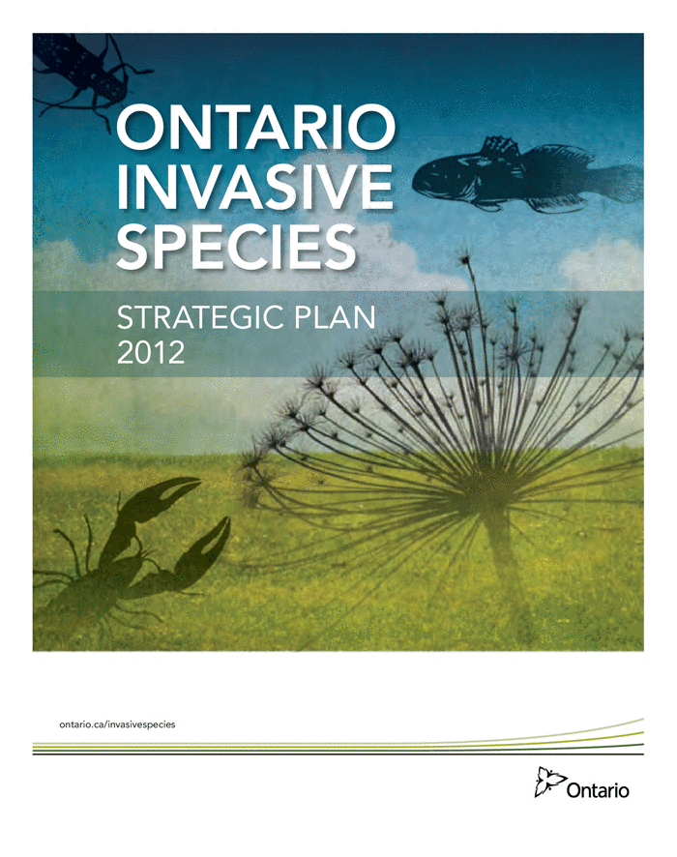
Ontario: Invasive Species Management Tools
Partnerships
Invasive Species Centre
Ontario Federation of Angler and Hunters
Ontario Invasive Plant Council
Policy
Ontario Invasive Species Strategic Plan
Biodiversity: Its in Our Nature
Collaboration
Federal Provincial Territorial Invasive Aquatic Species Task Force
Canadian Council of Forest Ministers
Conference of Great Lakes and St. Lawrence Governors and Premiers
Legislation
Ontario Invasive Species Act
Canada Aquatic Invasive Species Regulations

Slide 4
Invasive Species Act, 2015: Status
The Act and Ontario Regulation 354/16 took effect on November 3, 2016.
https://www.ontario.ca/laws/statute/15i22
Decision notice for the policy document: “Guidance for Invasive Species assessments under the Invasive Species Act, 2015” was posted to the Environmental Registry on September 12.
Environmental Registry number: 012-7673

Slide 5
Legislation: Key Principles
Prevention First
Prevent new invaders from arriving and slow spread of existing invaders where possible
Science Based
Risk assessments will at a minimum consider the species presence in Ontario, biological characteristics, risk of harm to the natural environment, dispersal ability and social or economic impacts
Enabling Framework
Tools to support prevention, detection, control, and eradication actions by the government, partners and the public
Shared Accountability
Enable partnerships and provide authority to delegate to, and empower others
Cost Recovery
Mechanisms to recover expenses as a result of infractions under the legislation
Inter-government Cooperation
Recognition of the mandated role of federal government. ISA complements their role, does not require province to assume new responsibilities.

Slide 6
Invasive Species defined in the Act?
Definition in the Act:
A species that is not native to Ontario, or to a part of Ontario, and:
Is harming the natural environment of Ontario or of the part of Ontario in which it is present, or
Is likely to harm the natural environment of Ontario or of a part of Ontario, regardless of whether it is present in Ontario or in a part of Ontario
Includes:
Plants, animals, or micro-organisms (e.g., a virus) that are not native to Ontario, or to a part of Ontario, that may harm the natural environment and negatively impact associated economic and social benefits

Slide 7
Regulating Invasive Species
Invasive Species
May regulate invasive species based on a number of considerations, including species’ biological characteristics, risk of harm to the natural environment, dispersal ability and social or economic impacts assessed through the use of risk assessments
Two classes
Prohibited:
Full suite of prohibitions apply
No person shall - Bring into Ontario, Possess, transport, propagate, buy, sell, lease or trade
Restricted:
No person shall bring an invasive species into Provincial Parks and Conservation Reserves; or deposit or release in Ontario
Additional prohibitions may be applied through regulation

Slide 8
Designation of Species, Carriers and Control Areas
Temporary Designation (Minister’s Order)
Minister may make an order to temporarily designate an invasive species under the legislation for up to two years.
Carriers (Regulation)
Carriers are things that are capable of moving an invasive species or many invasive species from one area to another.
Examples: boats, bait, firewood, horticultural plants
Invasive Species Control Areas (Regulation)
May regulate areas of Ontario as control areas for one or more invasive species.
Measures would be established to prevent the introduction or control the spread of the invasive species.

Slide 9
Enabling Regulated Activities
Authorizations
Enable possession, transport, purchase etc. of a regulated species for the purposes of:
Research and Education,
Prevention, control or eradication of an invasive species, or
A purpose prescribed in regulation.
Agreements
Minister may enter into agreements for the purposes of prevention, detection, control, and eradication of invasive species; monitoring and reporting; education and research; assessment of risk; and the preparation of prevention and response plans.
Prevention and Response Plans
Minister may require that a Plan be prepared for invasive species;
Plans will enable enhanced partnerships and actions to support the prevention and control of invasive species.

Slide 10
Enabling Early Detection, Rapid Response and Control
The Act provides inspector’s, enforcement officers and the Minister scalable powers to enable early detection, control and eradication of invasive species.
Provides the authority for the Minister to appoint a person or class of persons as inspectors in addition to enforcement officers (i.e., MNRF conservations officers and park wardens).
The most intrusive powers, (e.g., destruction of private property) can only be authorized by the Minister and are intended for use only in high ecological risk situations. Compensation may be paid in specified circumstances.

Slide 11
Detection
Inspection to Survey
To detect the presence of invasive species and monitor their spread
May inspect anything (excluding buildings/structures) conduct tests, take measurements/specimens/samples, set up equipment.
Unknown Species Order
Inspector has reason to believe the species is an unregulated invasive species and requires time to determine the potential threat to natural environment.
Ability to prohibit movement, isolate species/thing, set up barriers, prohibit people from moving/accessing species/thing. Limited to 15 days
Stopping conveyances to inspect
May stop a conveyance if there are reasonable grounds to believe that there is an invasive species or a carrier on the conveyance, or stopping the conveyance would assist in determining compliance.

Slide 12
Compliance
Inspection to determine compliance
Determining compliance with the proposed Act or the regulations, or a condition or an authorization, agreement, plan or order made by an inspector or the Minister.
Inspector may enter and inspect any land, building (not dwellings) or other place if the inspector has reasonable grounds to believe that a regulated invasive species or a carrier is present.
Compliance Order
Where the inspector believes the person is or is about to contravene the proposed Act or the regulations, a condition of an authorization, agreement, plan or order.
May require the person to stop any act or activity that is prohibited; comply with any direction set out in the order to achieve compliance, prevent the continuation of the contravention.

Slide 13
Control/Eradication
Inspector may make an order declaring land, a building or structure to be an Invaded Place if there is evidence that a regulated invasive species is present and the order is required to:
Prevent the invasive species from spreading to areas outside of the place, or
To control, remove or eradicate the invasive species that is on or in the place

Slide 14
Enforcement
MNRF Conservation Officers
Authority for officers to obtain search warrants, conduct tests, obtain documents, seize things, make arrests and issue stop orders
The Minister may appoint a person or classes of persons as enforcement officers.
Penalties
Maximum fines of $250,000 for individuals (plus possible imprisonment for up to 1 year) and $1,000,000 for corporations (doubles on subsequent offences)
Fine may be multiplied by the number of animals, plants or other organisms involved
Fine may be increased to an amount equal to any monetary benefit obtained as a result of the commission of the offence
Cost Recovery
a person who failed to comply would be liable for control or eradication expenses incurred by the Crown

Slide 15
Regulation Summary (O.Reg 354/16)
Prohibited Species |  |  | Restricted Species
Fish: Bighead carp Silver carp Grass carp Black carp Stone moroko Zander Wels catfish Family Channidae: Northern snakehead | Aquatic invertebrates: Killer shrimp Yabby (crayfish) Golden mussel | Plants: Hydrilla Brazilian elodea Water soldier European water chestnut Parrot feather | Plants: Phragmites Dog Strangling Vine Black Dog Strangling Vine Japanese Knotweed
Prohibitions: No bringing into Ontario No deposit or release in Ontario No possession or transport No propagation No buying, selling, leasing or trading. Exceptions for: dead and eviscerated carp(s), snakehead(s), zander In water movement of Water Soldier and Water Chestnut |  |  | Prohibitions: All of Ontario No bringing into Ontario No deposit or release No propagation No buying, selling, leasing or trading. Provincial Parks and Conservation reserves No bringing into and no possession or transportation Exceptions for: Deposit and release as part of control or management activities and other activities the purpose of which is not to deposit or release the species e.g. agriculture, infrastructure maintenance
General Exceptions: Emergency response activities e.g., fire, policy, natural disaster etc. Incidental catch of fish Possession, storage etc. of preserved specimens

Slide 16
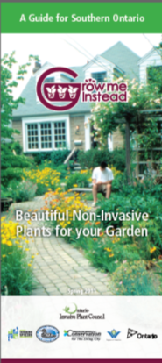
Partners Communication and Education
Websites:
Ontario Invasive Plant Council
http://www.ontarioinvasiveplants.ca/
Invasive Species Centre
http://www.invasivespeciescentre.ca
http://forestinvasives.ca/
OFAH - Invasive Species Awareness Program
http://www.invadingspecies.com/
EDDmaps
http://www.eddmaps.org/ontario/

Slide 17
Questions/Discussion
Jeremy Downe
Invasive Species Program/Policy Advisor
705 755 5408
jeremy.downe@ontario.ca
Invasive Species Act, 2015
https://www.ontario.ca/laws/statute/15i22

